Slide 1
PII DETECTOR AND MASKER
Category: Data Engineering
Submitted by Team 13
V. Anjali
S. Venkata Hemanth Kumar
K. Sai sri
S. Sri Ramya

Slide 2
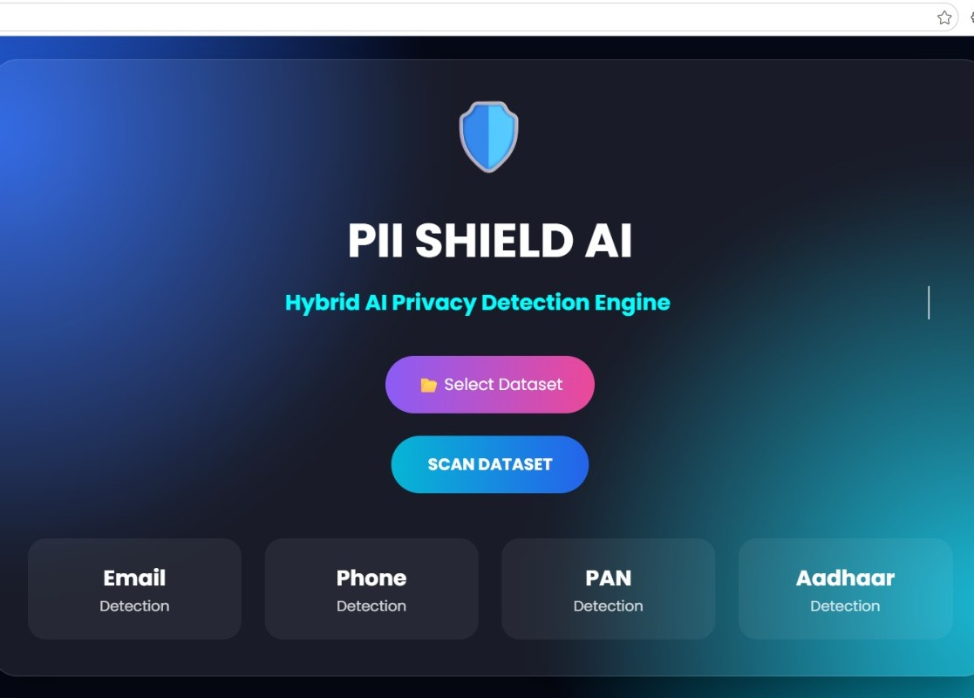
Interface:
Simple and user-friendly interface for easy operation.
Supports uploading datasets in CSV and JSON formats.
Displays detected PII categories clearly.
Shows masked output data in a structured format.
Generates a detailed PII detection report.

Slide 3
Problem Statement:
Data breaches in 2024-2025 exposed millions of Aadhaar, phone, and email records in India
DPDP Act 2023 and GDPR mandate strict protection of personal data. Non-compliance = heavy fines
Manual redaction is infeasible for large datasets. Need automated, accurate, scalable solution
Rising data breaches expose Aadhaar, phone, email, financial data
Non-compliance with GDPR, DPDP Act leads to legal and reputational risk
Manual redaction is slow, error-prone, and doesn’t scale

Slide 4
What is PII?
Sensitive PII: Aadhaar, PAN, Passport, Bank details
Non-sensitive PII: Email, Phone, Address, Name
Direct identifiers: Aadhaar, PAN, Passport, Phone, Email. Can identify a person alone
Quasi-identifiers: Age, Gender, Address. Can identify when combined
Sensitive vs Non-sensitive: Health, financial data are sensitive. Name, city are less sensitive but still risky
Goal: Identify and protect data that can lead to identity theft

Slide 5
Objectives:
Detect PII entities in text, documents, and databases
Classify PII type using rules + ML models
Mask or redact data while preserving format and utility
Detect PII across unstructured text, PDFs, CSVs, and database dumps
Classify PII into types like Name, Email, Financial ID using rules and ML
Mask data using reversible and non-reversible methods without breaking data format
Maintain high precision and low latency for real-world use

Slide 6
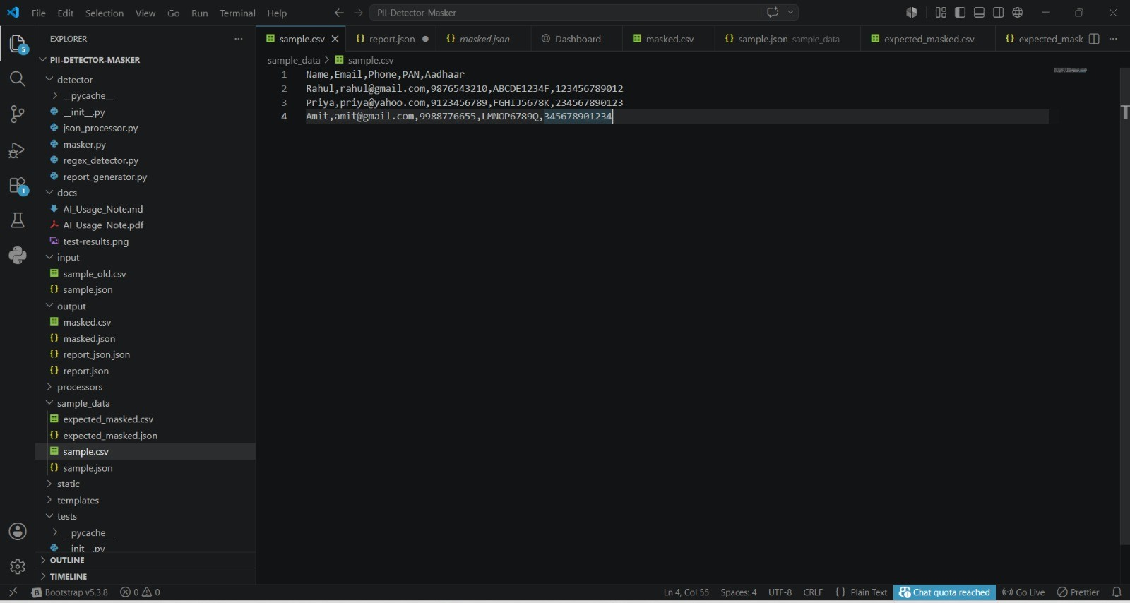
Example Csv dataset:

Slide 7
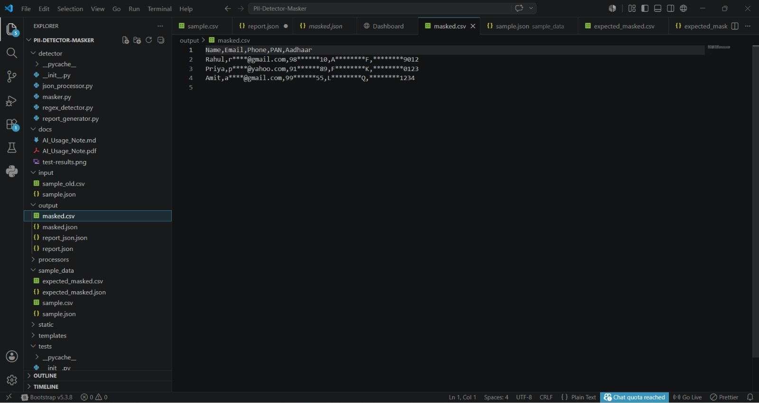
Masked Dataset

Slide 8
System Architecture/Workflow:
Upload Dataset
Read CSV/JSON
PII Detection
Classification
Data Masking
Report Generation
Download Output

Slide 9
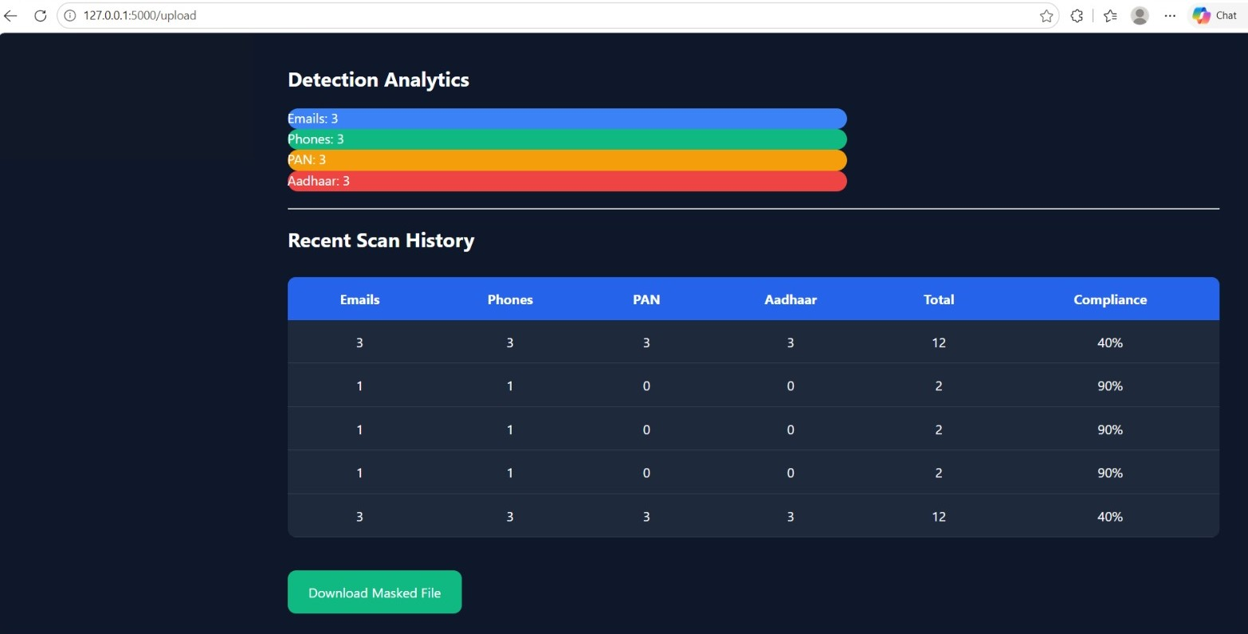
Detection Analysis:

Slide 10
Tech Stack & Models:
Backend
Python
Flask
Data Processing
Pandas
JSON
Frontend
HTML
CSS
JavaScript

Slide 11
Implementation Details:
Hybrid Detection: Regex catches 100% of pattern-based PII. NER catches contextual mentions like “John’s email is…”
Custom Rules: Added regex for Indian formats: Aadhaar ^\d{4}\s\d{4}\s\d{4}$, PAN [A-Z]{5}[0-9]{4}[A-Z]Masking Strategies: Full mask: XXXXXXXX9012Partial mask: 9XXXXX9012 Hash: sha256 for irreversible masking
Tokenization: Replace with PERSON_1, EMAIL_1 for ML training
Post-processing: Validate format post-masking to avoid breaking CSV/JSON structure

Slide 12
Demo:
The Demo showcases the complete workflow of the PII Detector & Masker system. A dataset containing personal information is uploaded, processed through the detection engine, classified into PII categories, and then masked. Finally, the system generates a masked dataset and a detailed detection report for download.

Slide 13
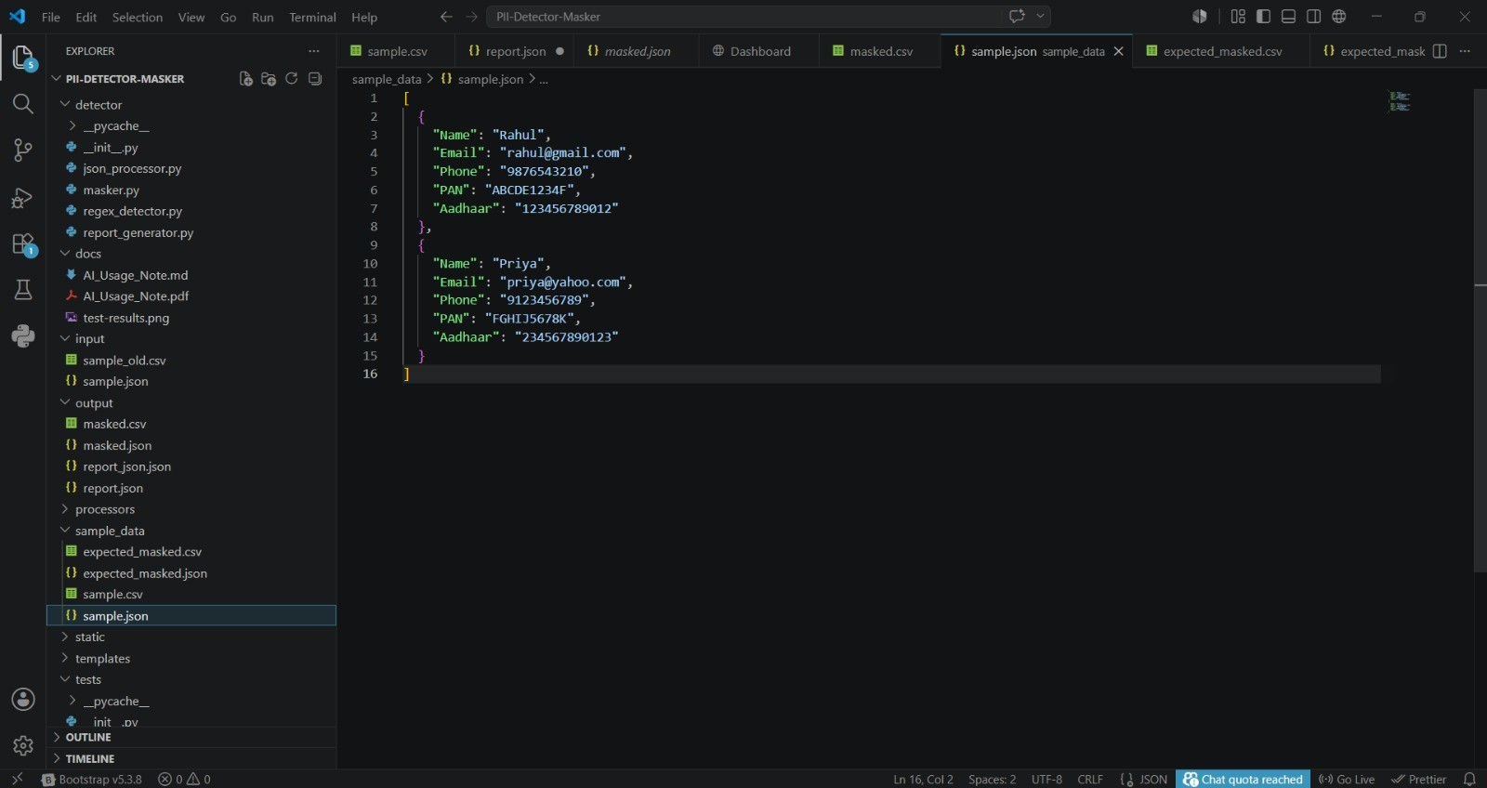
Input: Dataset

Slide 14
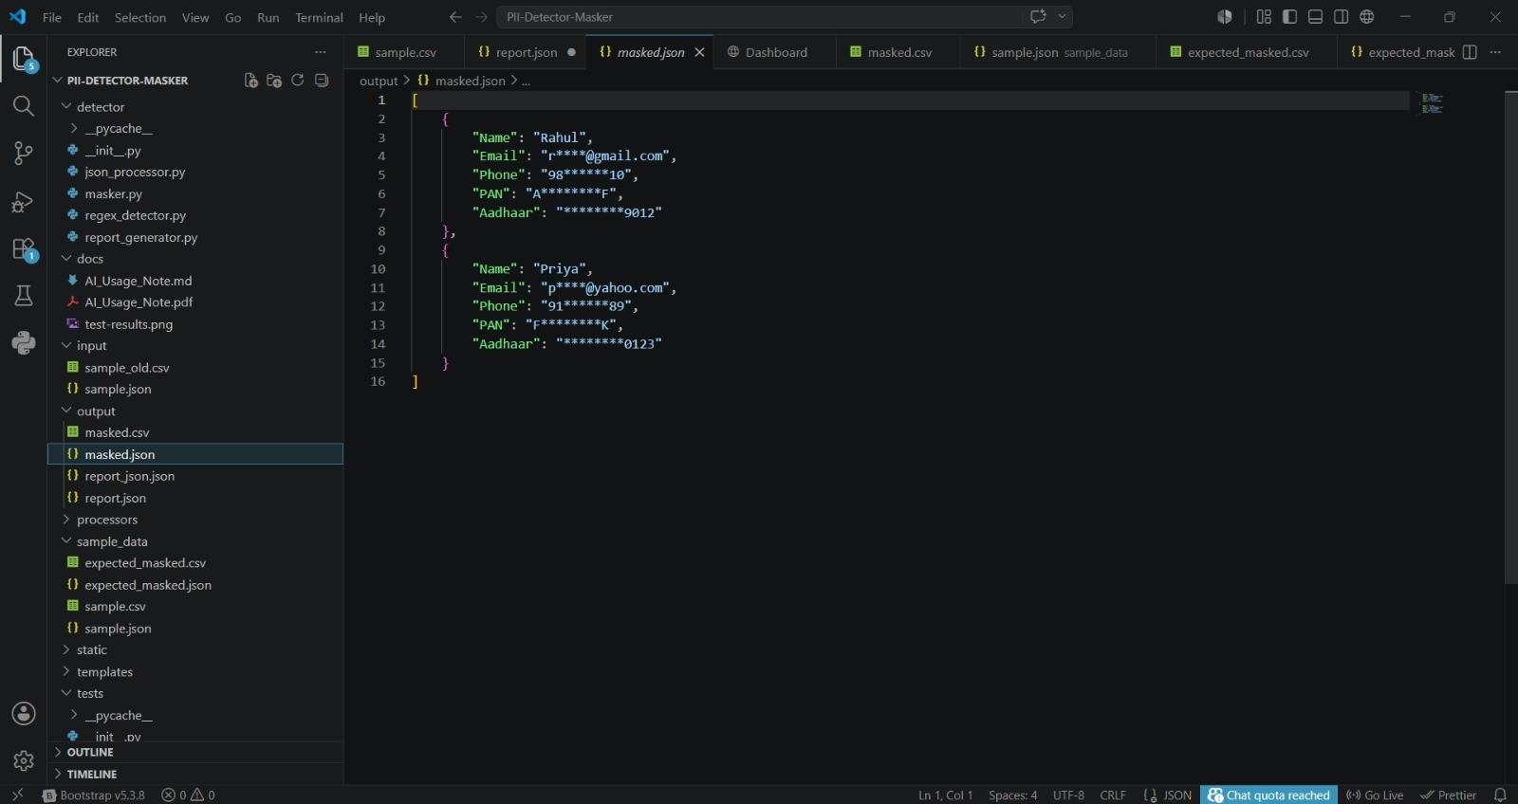
Output: Masked dataset

Slide 15
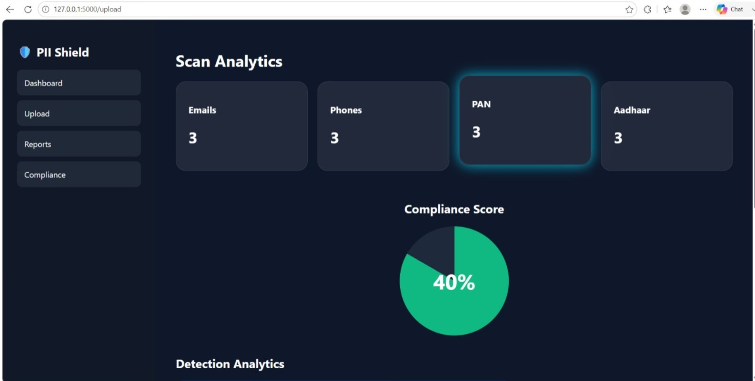
Scan Analysis:

Slide 16
Challenges & Future Scope:
Challenges:
False positives on names like “Apple” vs company
Multilingual PII in Hindi, Telugu text
Context ambiguity in free-form text
Future Scope:
Fine-tune IndicBERT for Indian languages
Build web UI for non-technical users
Package as pip library and REST API for production use
Add audit logs for compliance reporting

Slide 17
Conclusion:
The PII Detector & Masker successfully identifies and protects sensitive information present in datasets. By combining Regex-based pattern matching with LLM-based intelligent detection, the system accurately detects Personally Identifiable Information such as emails, phone numbers, PAN numbers, and Aadhaar numbers. The masking process ensures data privacy while maintaining the usability of the dataset for analysis and sharing. This solution helps organizations comply with data protection regulations and reduces the risk of sensitive information exposure.

